Slide 1

Analyzing Engagement and Success Metrics of New Search feature
User actions to track for Measuring Search Engagement
Metrics for reporting the feature performance
Determining feature success
Additional data insights for analysis and recommendation
Presented by-
Revathi Nambiar

Slide 2
User Actions to track
Metrics for reporting the feature performance
Number of search queries: keeping track of how many searches users conduct
"View Details" Clicks: tracking how frequently users click on the "view details" button can help us know if right products are being retrieved
Actions for "Add to List": keeping track of how many items users add to their shopping lists
Shopping List Completion Rate: measuring how often users complete their shopping lists (share or print)
Conversion Rate = # of users who completed the shopping list (purchased)
Average items added to shopping list per user
Bounce rate from search results
Average number of sessions users launched
Average time spent on search results page
Query reformulation rate

Slide 3
Determining feature success
Additional Data Insights
User Journey Analysis: Examine the user journey leading up to and following a search (add to cart)
Training the search algorithm with synonyms,contextual words etc
Positioning the relevant flyer page alongside the retrieved product
Monitor search response times and performance, ensuring that searches are fast and reliable (no-results queries)
Analyzing how user engagement with the search feature evolves over time (like weekly ,mom)
Perform test vs control analysis for metrics like conversion rate ,time spent, launched sessions etc
Gather user feedback and ratings to gauge satisfaction with the search feature

Slide 4
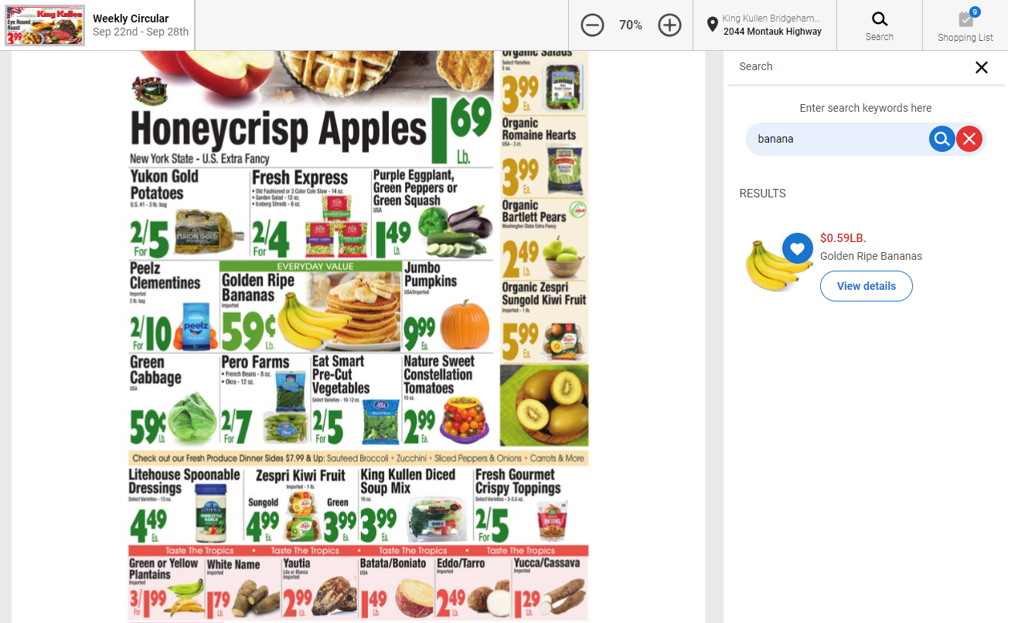

Slide 5
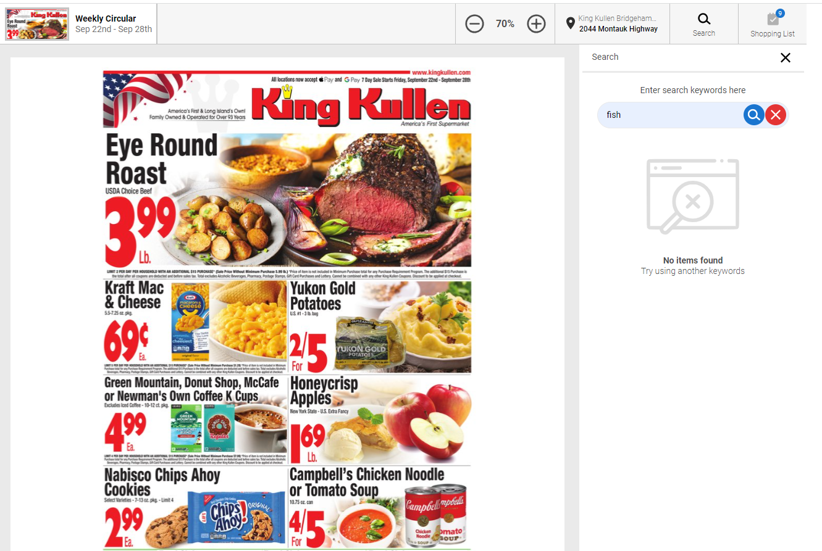

Slide 6
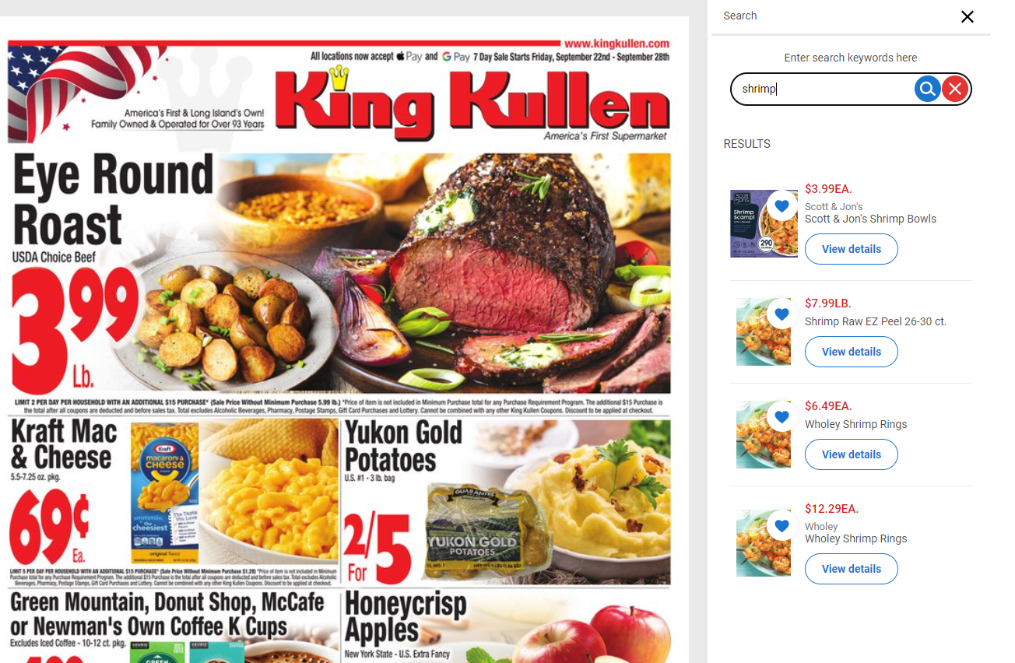

Slide 7
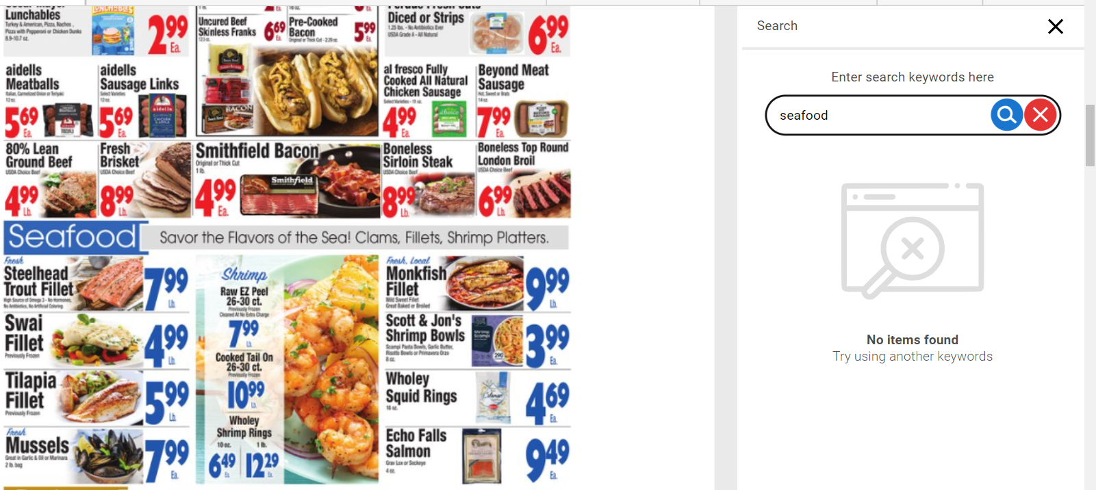

Slide 8
AB Test Result Analysis

Slide 9
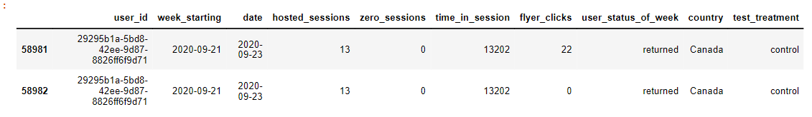
AB test result analysis
Null value check
Data type validation
Removing duplicates
Removal of unwanted columns
Data consistency check
Data loading and cleaning

Slide 10
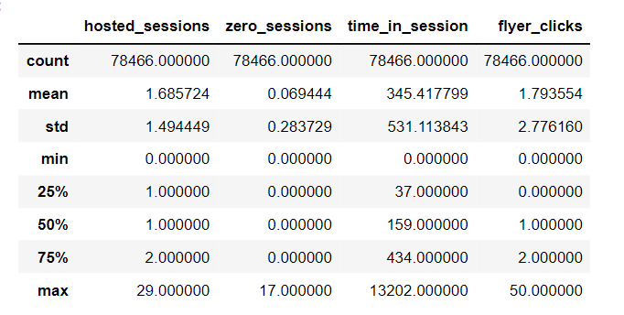
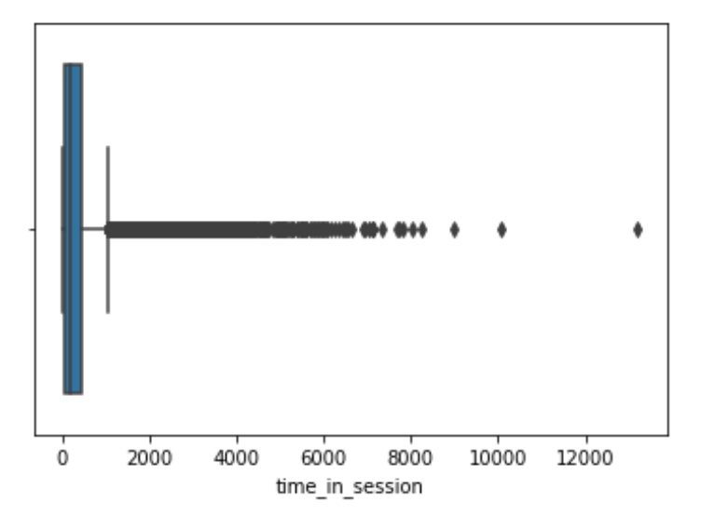
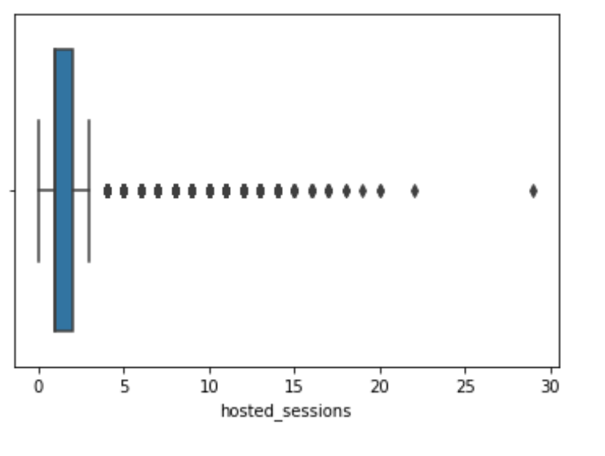
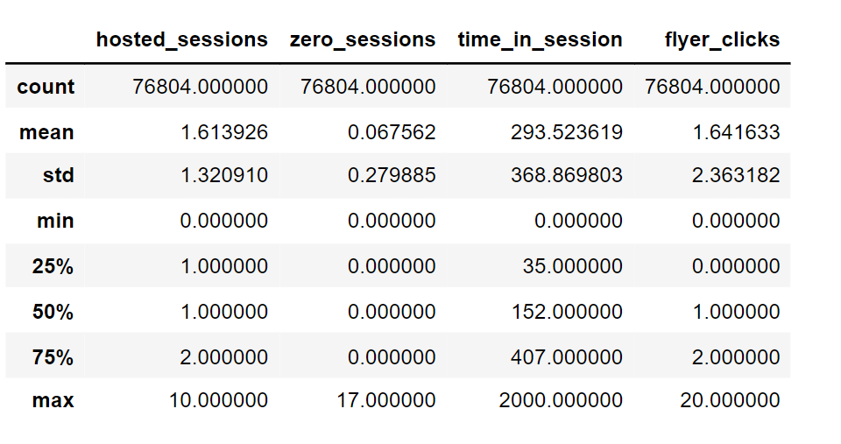
AB test result analysis
Assumptions
Outlier detection and removal
Any extreme values that deviate significantly from the typical user engagement patterns are considered outliers
The conventional outlier detection had a noteworthy impact on the analysis, favoring the control set in a markedly different manner
Notes:
A scenario where 'time_in_session' is 13202 seconds, 'flyer_clicks' is 22, and 'hosted_sessions' is 13 can be unusual and may indicate a few different possibilities like data collection error, bot or automated or test platform error. Another entry hosted_session=1 , time_in_session=2132 and click=1

Slide 11
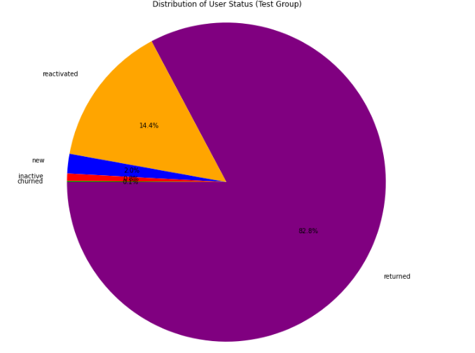
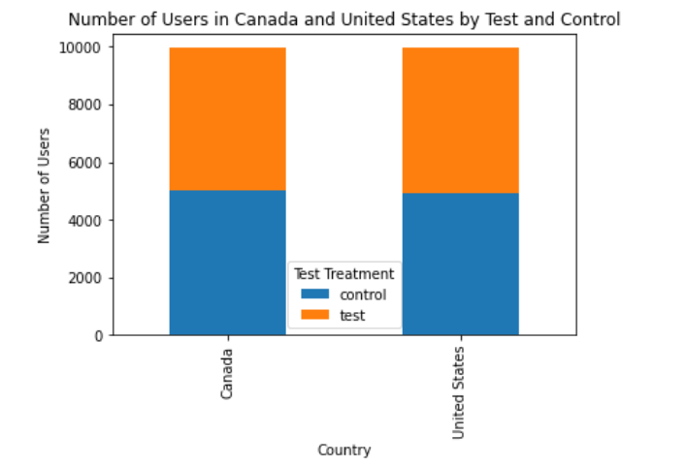
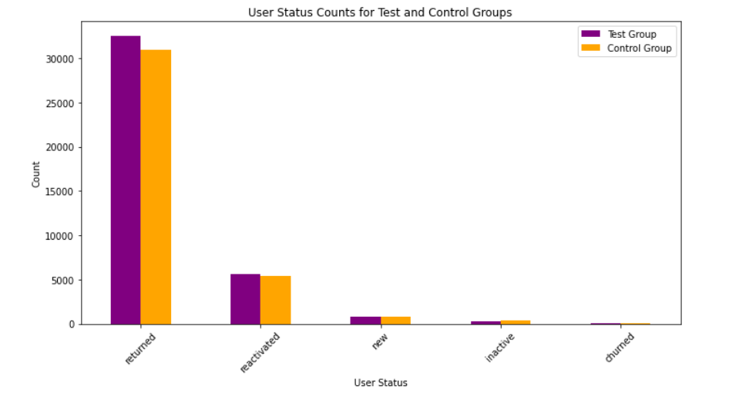
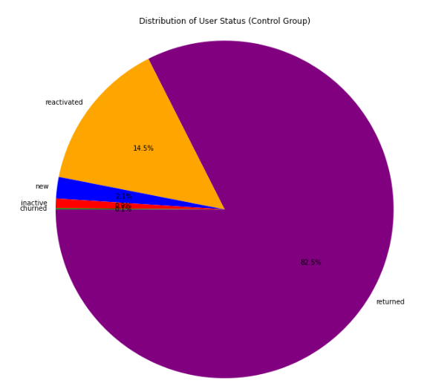
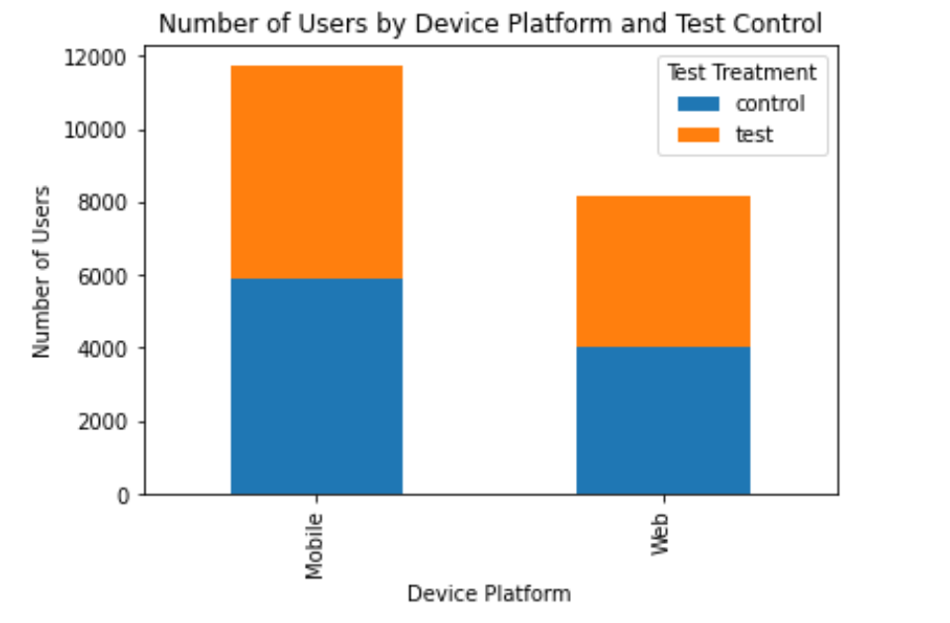
AB test result analysis
Data visualization
Notes:
Test Group User Status Counts:
returned 32532
reactivated 5651
new 779
inactive 297
churned 41
Control Group User Status Counts:
returned 30923
reactivated 5422
new 771
inactive 347
churned 41

Slide 12
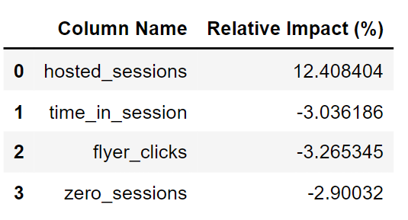
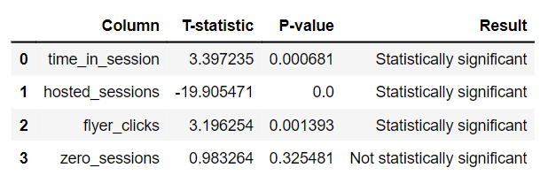
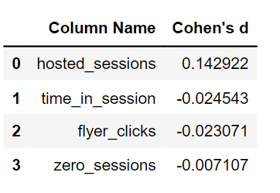
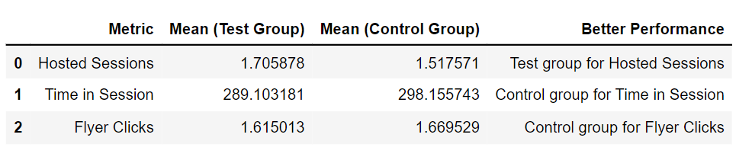
AB test result analysis
Result statistics

Slide 13
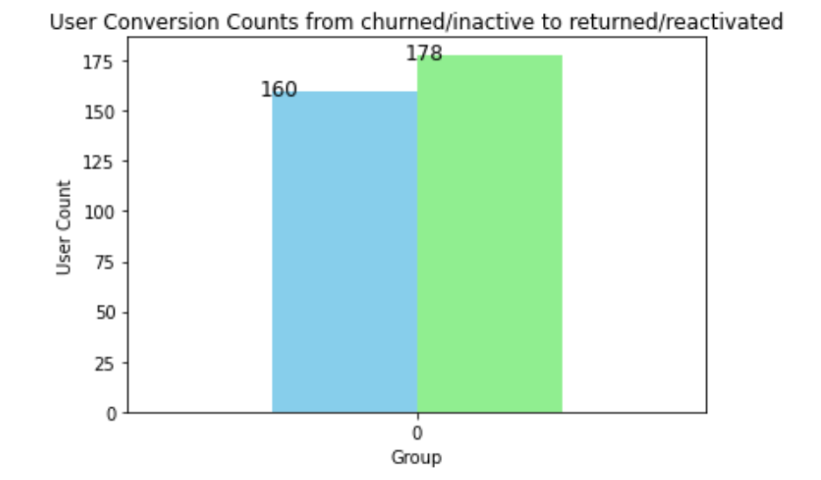
AB test result analysis
The test group exhibits a higher number of returning users compared to the control group
When analyzing average weekly and overall hosted sessions, the test group consistently outperforms the control group
The relative impact (Cohen's d) of time spent by users and the number of flyer clicks is notably lower in the test group as compared to the control group. However Click-Through Rate (CTR) for the test group was slightly higher
In the test group, there are a higher number of users successfully converting from churned/inactive to returned/activated status in comparison to the control group

Slide 14
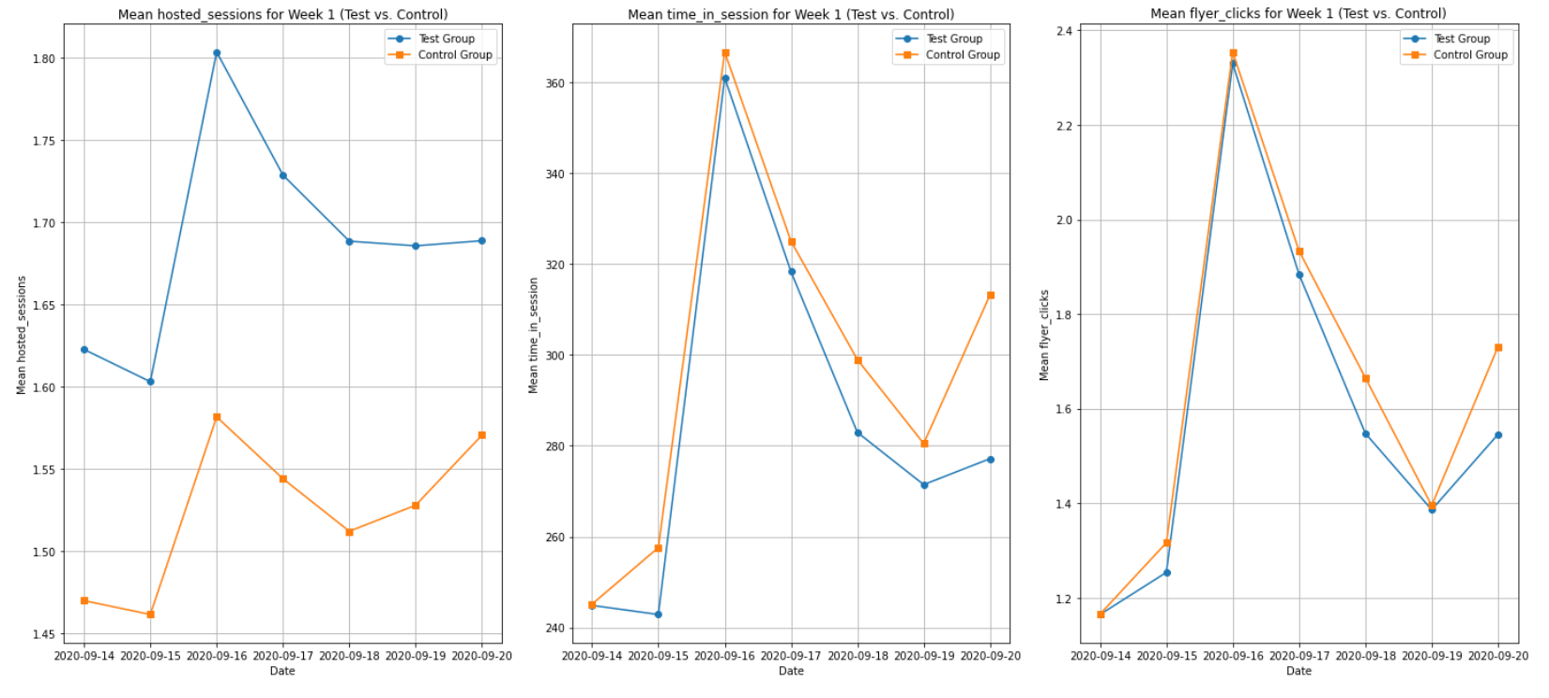
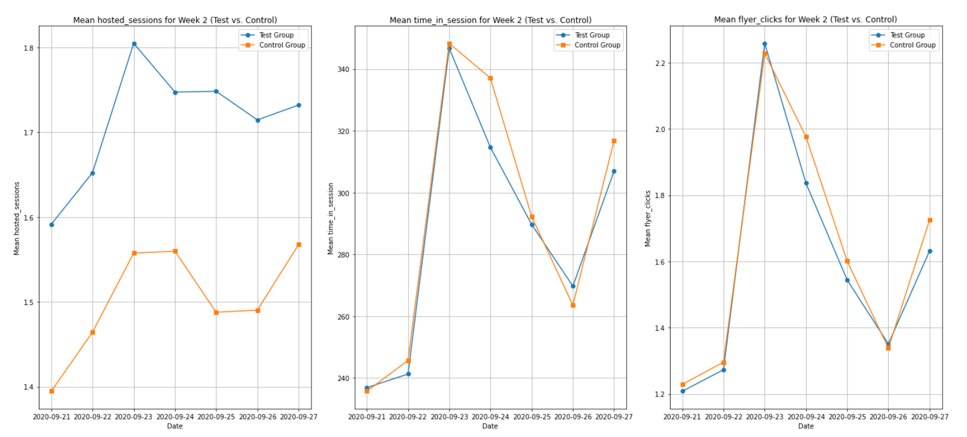
AB test result analysis
Notes:
On a weekly analysis test does better than control (especially towards the end), Wednesdays are at the peak.

Slide 15
THANK YOU
QUESTIONS?

